Slide 1
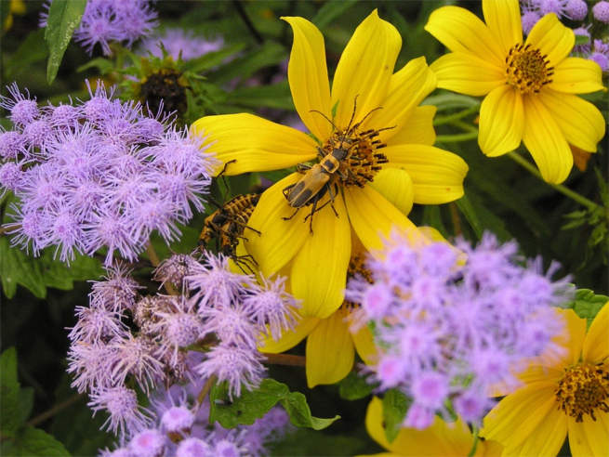
Pollinator-Friendly Parks
2023 MRPA Conference
Karyn Molines
Victoria Hall & Riley Brown
Calvert County Natural Resources Division
www.CalvertCountyMD.gov/NaturalResources
Notes:
Introduce myself (and other NRD)
Purpose of talk—
Objectives
Define pollinators and pollination, including life cycle and habitat needs of bees and butterflies
Identify threats to pollinators and actions park agencies can take to mitigate threats and protect pollinators and their habitats
Use examples from different parks to illustrate the four principles that support pollinator conservation.

Slide 2
Objectives
Why are Pollinators Important?
What Pollinates?
Parks are Important for Pollinators
Habitats for Pollinators
Assess Your Work & Agency
Identify Collaborators & Opportunities
Educating Others
https://www.nrpa.org/publications-research/best-practice-resources/parks-and-pollinators-taking-action-and-advancing-sustainability/
Notes:
https://www.nrpa.org/publications-research/best-practice-resources/parks-and-pollinators-taking-action-and-advancing-sustainability/
https://www.nrpa.org/globalassets/research/self-assessment-pollinator-checklist.pdf
Park and recreation agencies have a unique opportunity to help protect pollinators while advancing key sustainability plans and practices that strengthen the resiliency of their communities. Many agencies, municipalities and communities already are doing this work in some capacity. Success can be amplified by examining current efforts, identifying opportunities, and creating a team that can help build momentum and push goals forward.
Parks and Pollinators: Taking Action and Advancing Sustainability can help park and recreation professionals develop a process to assess, identify and develop the teams, practices and efforts needed to advance your pollinator and sustainability efforts. This resource also provides a self-assessment worksheet to examine work being done and a chart to inventory potential partners that can be found here: Self-Assessment for Pollinator Friendly and Sustainable Parks
“Self-Assessment for Pollinator Friendly and Sustainable Parks”
“Identify Collaborators and Opportunities”

Slide 3
Natural Resources Division
OUR MISSION
To preserve, manage and operate natural resource areas to provide compatible outdoor recreation and educational opportunities for the public.

Slide 4
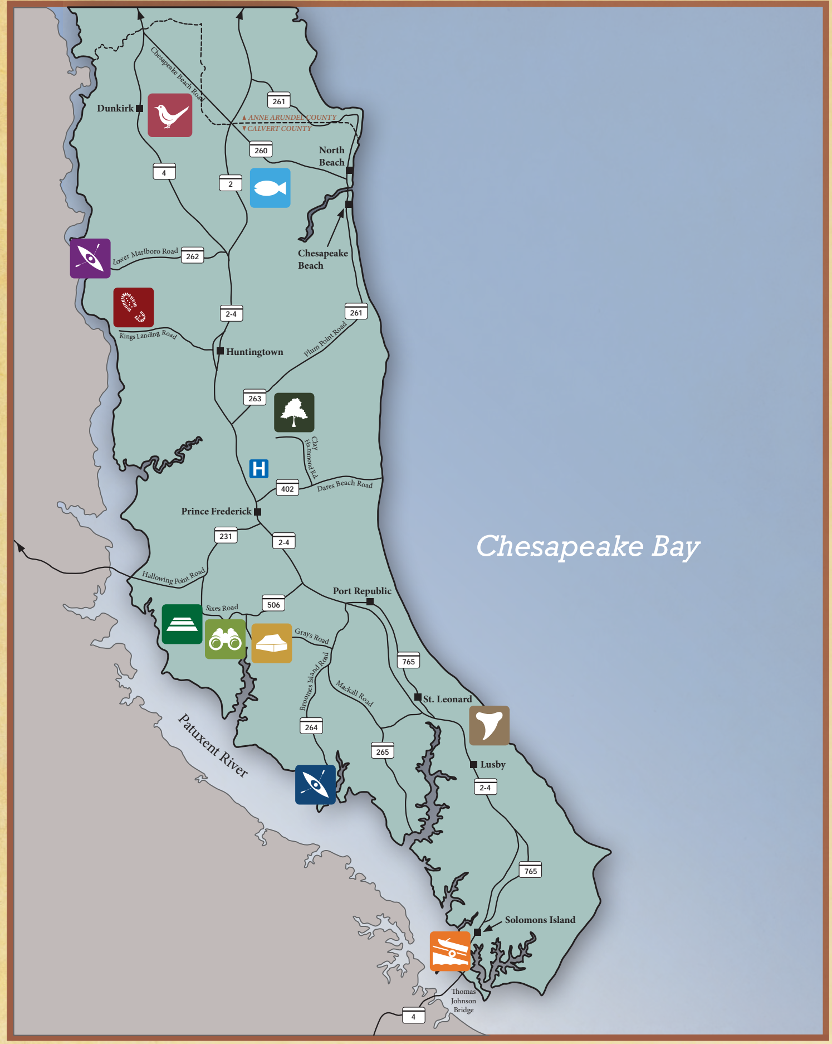
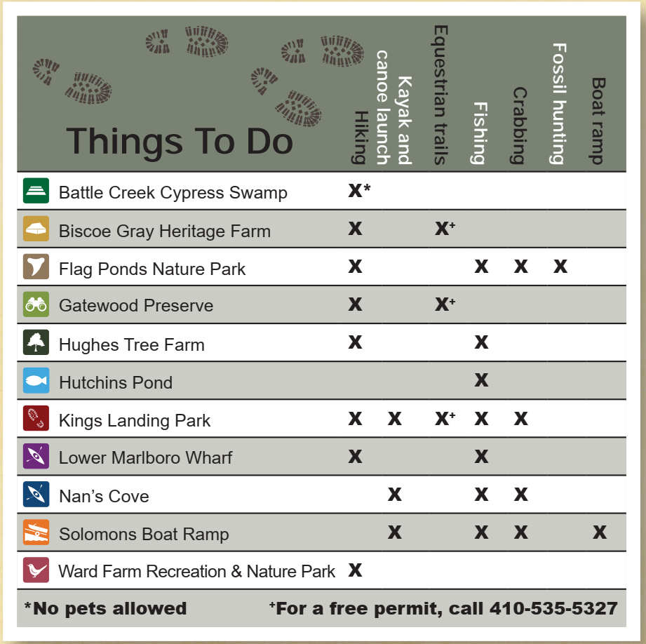
Outdoor Recreation
Habitat Management
Forests
Wetlands
Shoreline
Meadows
Community Engagement
Approx. 1,600 acres
Notes:
The Natural Resources Division manages over 1600 acres throughout the county
Each site provides a different set array of outdoor recreational opportunities.
At least one of our natural areas will satisfy your interest:
Hiking
Equestrian trails
Water access (kayaks, canoes, stand up paddleboards, motor boats)
Fishing & Crabbing
Hunting
Education programs
Interpretive exhibits
Rental facilities (pavilion, hall, camping) for events
NOTE: Not every site allows every activity. Please consult the web page or call the office for details

Slide 5
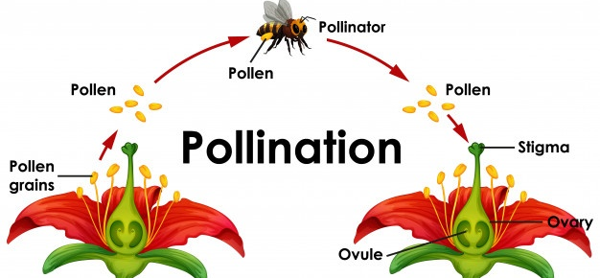
Pollination 101
https://www.ypsilibrary.org/2020/06/bees/

Slide 6
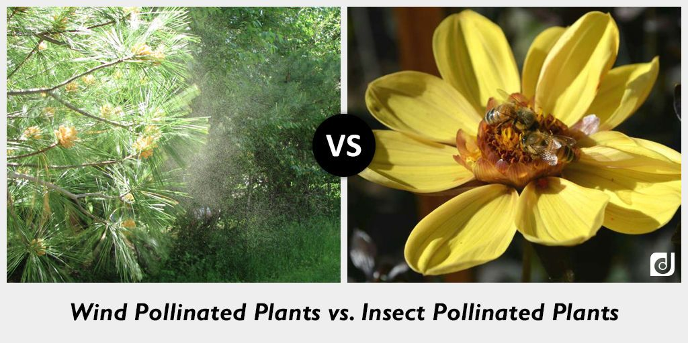
Notes:
Pollinator-Friendly Parks are managed for Insect Pollinated Plants. The Pollen from insect pollinated plants moves from flower to flower by the pollinator—therefore does NOT trigger seasonal allergies.

Slide 7
Pollinators
Bats
Birds
Wind
Plants
Bees
Flies
Beetles
Wasps
Moths
Butterflies
Ants

Slide 8
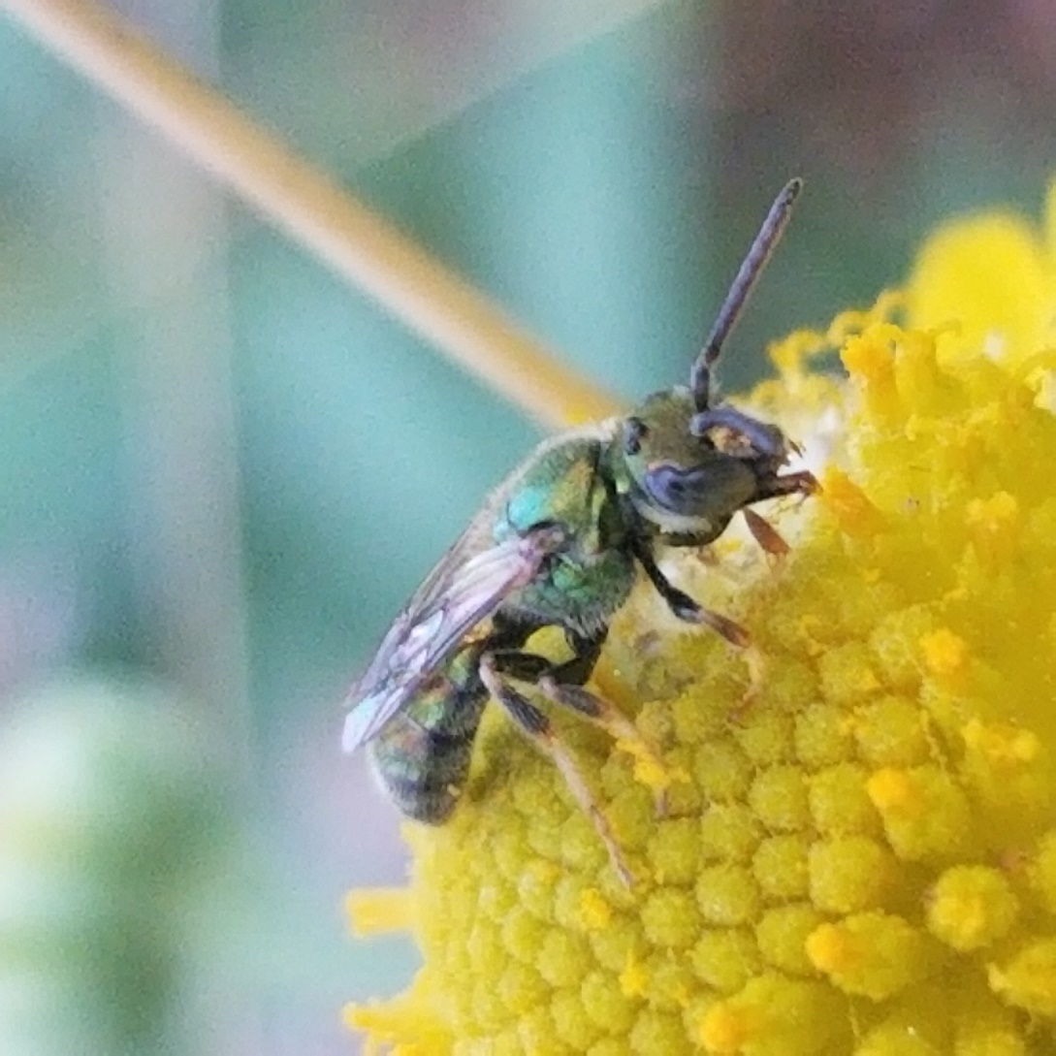
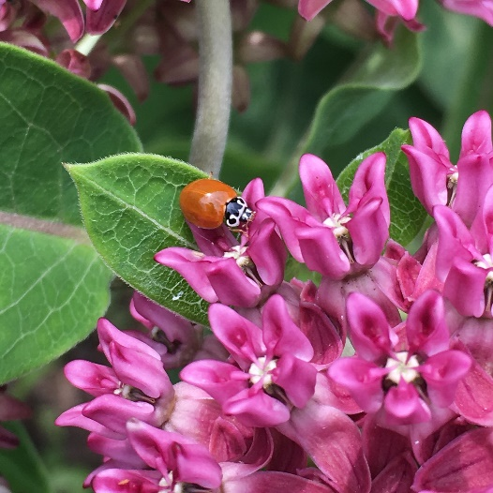
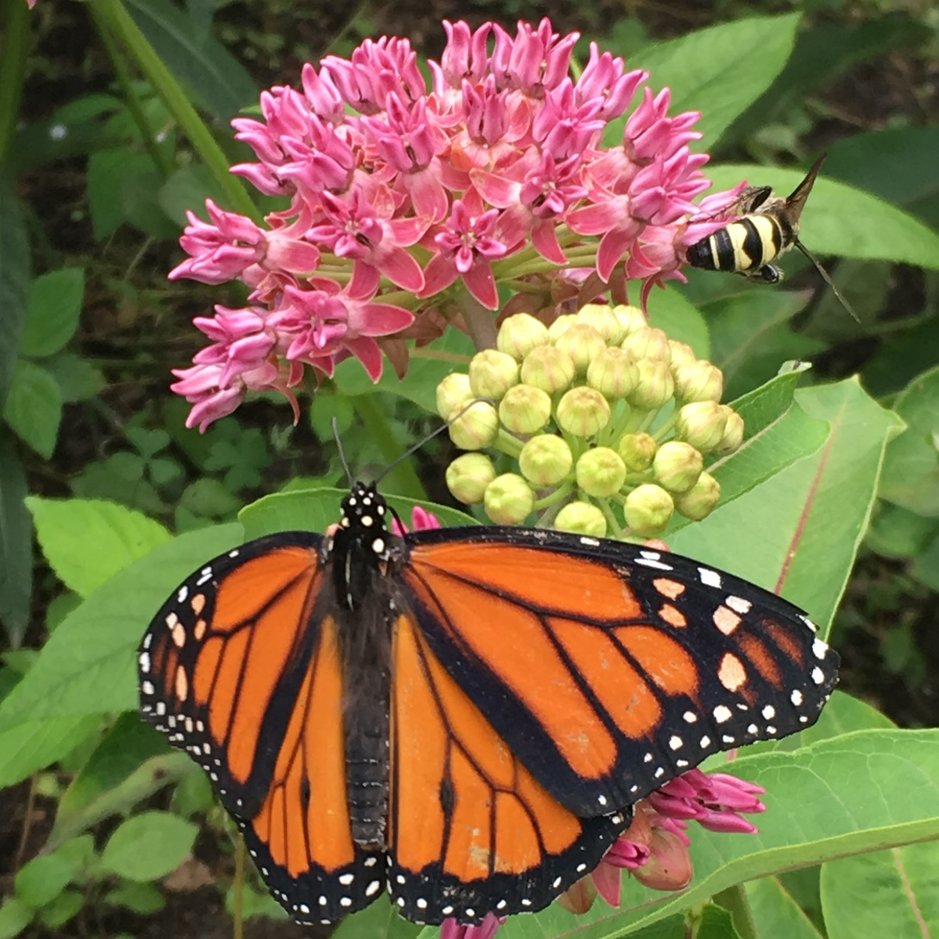
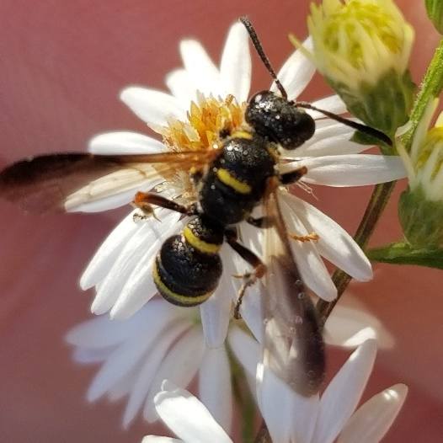
Quiz Time
Riley Brown and Tori Hall

Slide 9
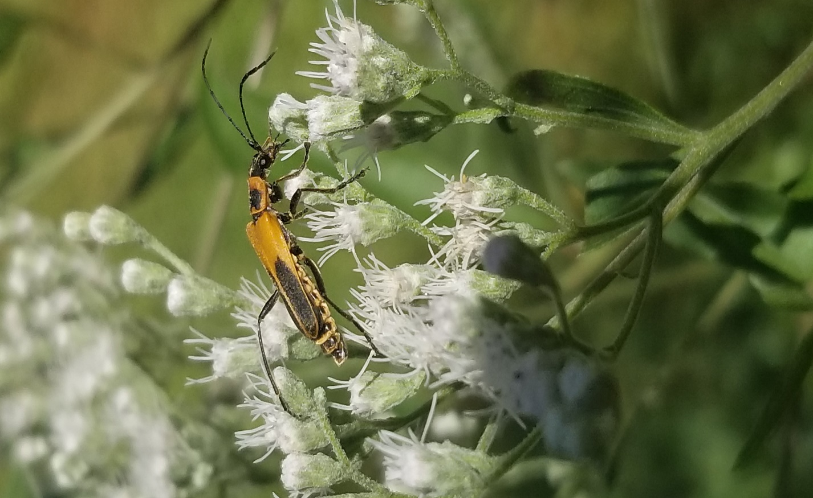
Why Are Pollinators Important?

Slide 10
Insects are Important
Critical Link in the Food Chain
Maintain Plant Diversity
80% of Plants Pollinated by Animals
Pollinate Plants
Maintain Plant Diversity
Critical Link in Food Chain
Notes:
No Insects→severe decline in pollination→no seeds
Decomposers

Slide 11
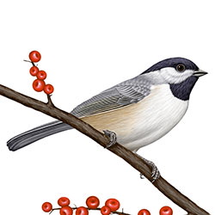
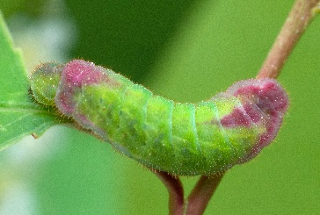
Foundation of Food Webs
Notes:
Plants are the framework, Insects are the currency (Doug Tallamy)
Coopers Hawk https://desertmuseum.org/visit/Backyard_Diversity_Bingo.pdf
A Cooper’s Hawk can eat an amount of food equivalent to 12% of its body weight in one day. This is similar to a 120-pound person eating 14 pounds of food – or about four or five large pizzas a day!
https://identify.whatbird.com/obj/820/identification/Carolina_Chickadee.aspx
Carolina Chickadees will feed their young ones 6000-9000 caterpillars before fledgling, meaning over sixteen days on average. After fledgling, nobody has counted, but fledged Chickadees get feed for up to three more weeks.
Here’s another: a Wilson’s Warbler pair were closely observed. The male carried food to the nest 241 times a day, the female 571 times a day. For five days. That’s a minimum of 4060 caterpillars, if each trip was one caterpillar’s-worth. Often as not there are more than one caterpillar in the parent’s bill, at least in places un-assaulted by chemical warfare and invasive species.
https://www.marylandbiodiversity.com/record/202298 (adult coral hairstreak)
https://alabama.butterflyatlas.usf.edu/species/details/136/coral-hairstreak (caterpillar)
Prunus: 340 Species of leps https://www.marylandbiodiversity.com/record/598078 (my photo)
Coopers Hawk https://desertmuseum.org/visit/Backyard_Diversity_Bingo.pdf
https://identify.whatbird.com/obj/820/identification/Carolina_Chickadee.aspx
https://www.marylandbiodiversity.com/record/202298 (adult coral hairstreak)
https://alabama.butterflyatlas.usf.edu/species/details/136/coral-hairstreak (caterpillar)
https://www.marylandbiodiversity.com/record/598078 (Karyn Molines)

Slide 12
Supporting Pollinators
River birch Betula nigra
284 species of caterpillar
Two Strategies
Host Plants for Caterpillars
Pollen for Specialist Bees
Notes:
https://mdflora.org/resources/Publications/GardenersGuidelines/gguidelines03.pdf FROM 2002

Slide 13
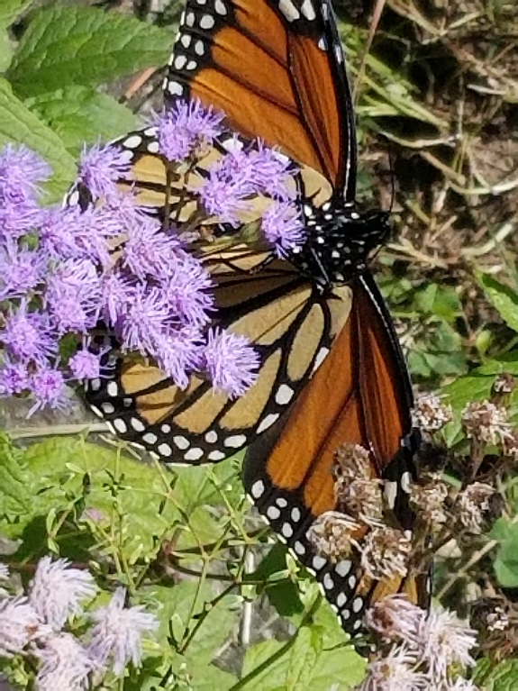
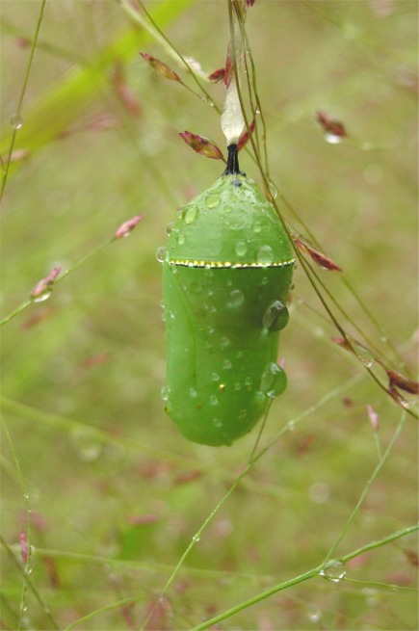
Adult
Egg
Pupa
Life Cycle
Larva
Photo by Sara Tangren
Life Cycle Craft
Notes:
Life cycle

Slide 14
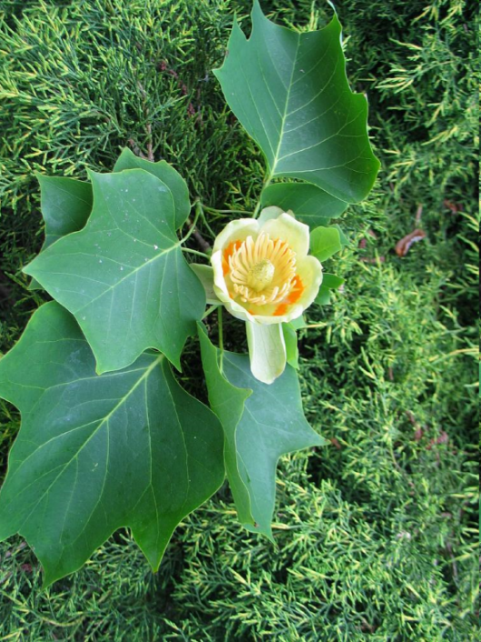
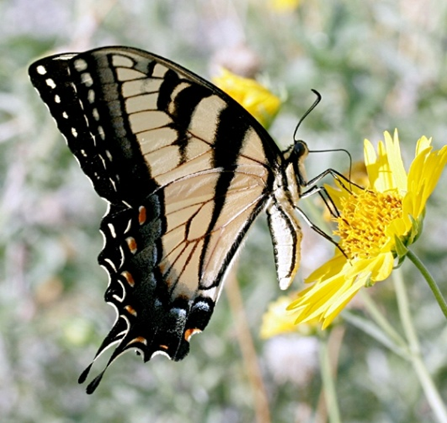
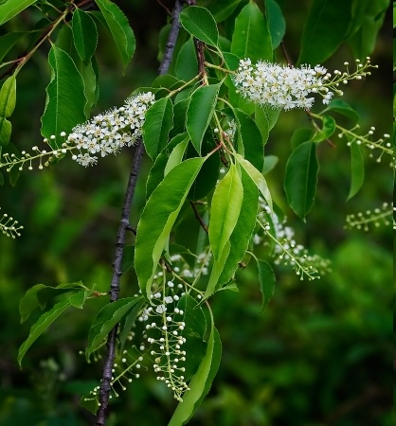
Nectar and Larval Host Plants
Tiger Swallowtail
Tuliptree
(Liriodendron tulipifera)
21 species of caterpillars
www.bomengids.nl
www.biol.vt.edu/digital_atlas/media/images/plants/
originals/Prunus_serotina1Mod%233293b%23.jpg
Black cherry
(Prunus serotina)
340 species of caterpillars

Slide 15
High Value Trees for Caterpillars
Quercus (Oaks)
550 species
Prunus (Cherry)
340 species
Acer (Maple)
238 species
Carya (Hickory)
213 species
Pinus (Pine)
200 species
Notes:
21 native species of Quercus
8 - Prunus
7 – Acer
6 - Carya
7 - Pinus

Slide 16
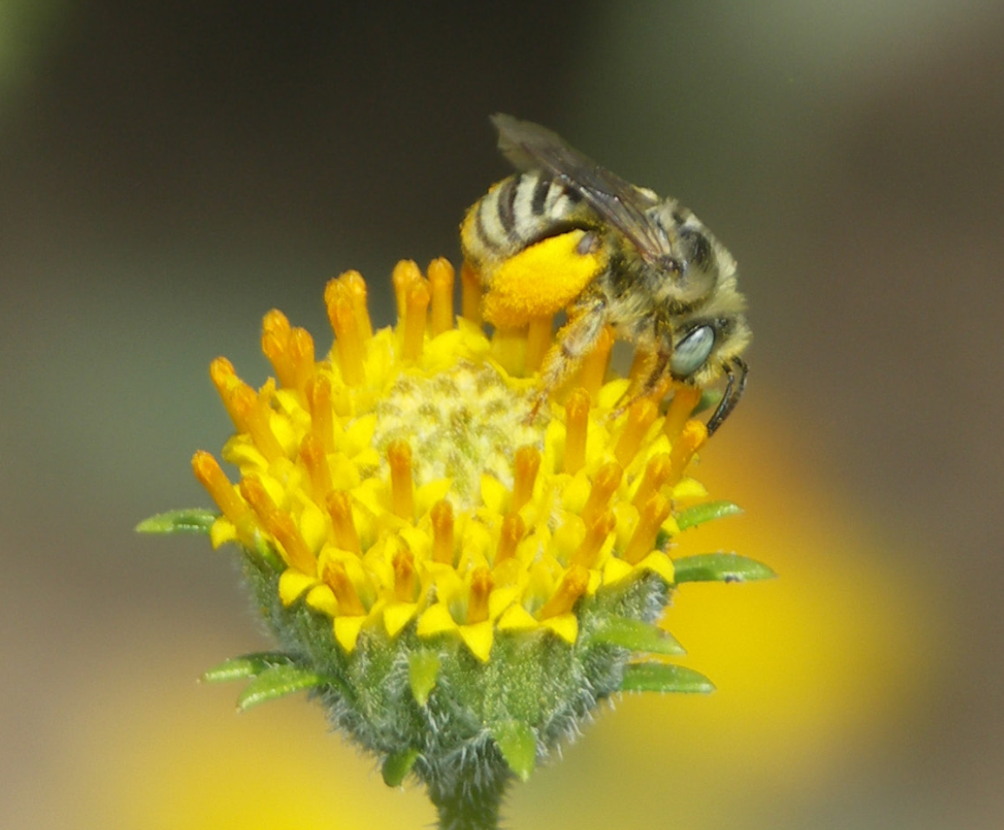
Plants for Pollen Specialists
Nectar provides energy
Pollen supports reproduction
Generalist pollinators will benefit if you plant for the specialists
Long-horned bee. Photo Mace Vaughan, Xerces Society
Notes:
https://en.wikipedia.org/wiki/Pollen#/media/File:Misc_pollen_colorized.jpg
Colorized scanning electron microscope image of pollen grains from a variety of common plants: sunflower (Helianthus annuus), morning glory (Ipomoea purpurea), prairie hollyhock (Sidalcea malviflora), oriental lily (Lilium auratum), evening primrose (Oenothera fruticosa), and castor bean (Ricinus communis).

Slide 17
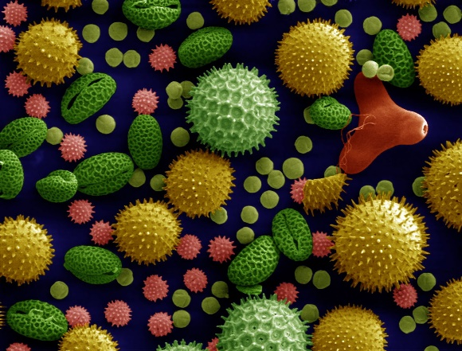
Pollination
Bloom Time
Visual Clues
Scents
Flower Morphology
Pollen Diversity
https://en.wikipedia.org/wiki/Pollen#/media/File:Misc_pollen_colorized.jpg
Photo by Sara Tangren

Slide 18
Solidago (Goldenrods) 33 Species in Maryland 42 Pollen-Specialist Bee Species
Mining bees (Andrena spp.)
Polyester bee (Colletes simulans armatus)
Long-horned bee (Melissodes druriella)

Slide 19
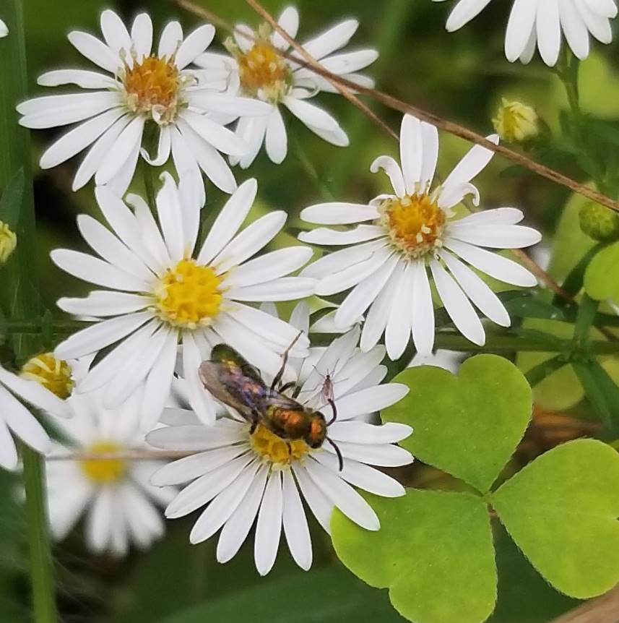
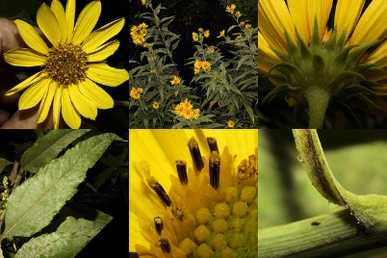
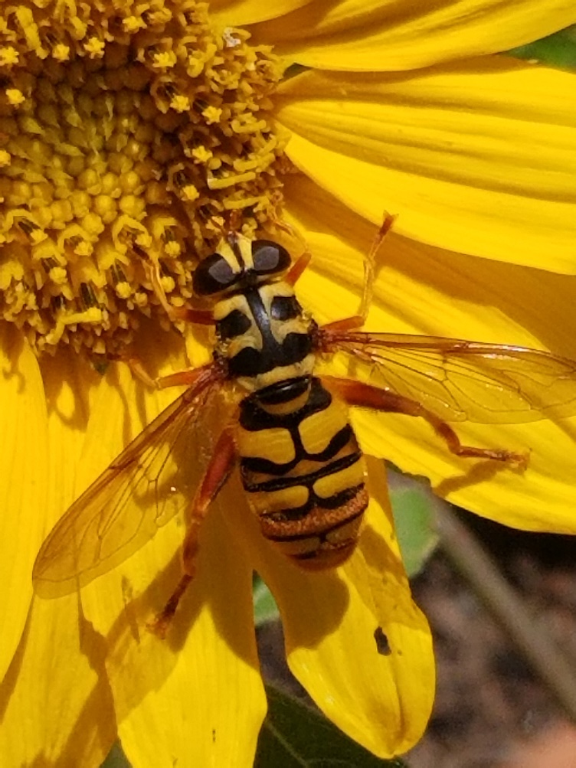
Helianthus (8 spp. Sunflowers)
Symphyotrichum (31 spp. Asters)
Bill Harms
https://www.marylandbiodiversity.com/record/374270
Notes:
Pollen providing species are primarily sun loving--

Slide 20
Threats
To Habitats
To Pollinators
Habitat destruction
Nonnative invasive species
Overpopulation of deer
Climate change
Pesticides
Habitat destruction
Light pollution
Nonnative and invasive species
Climate change

Slide 21
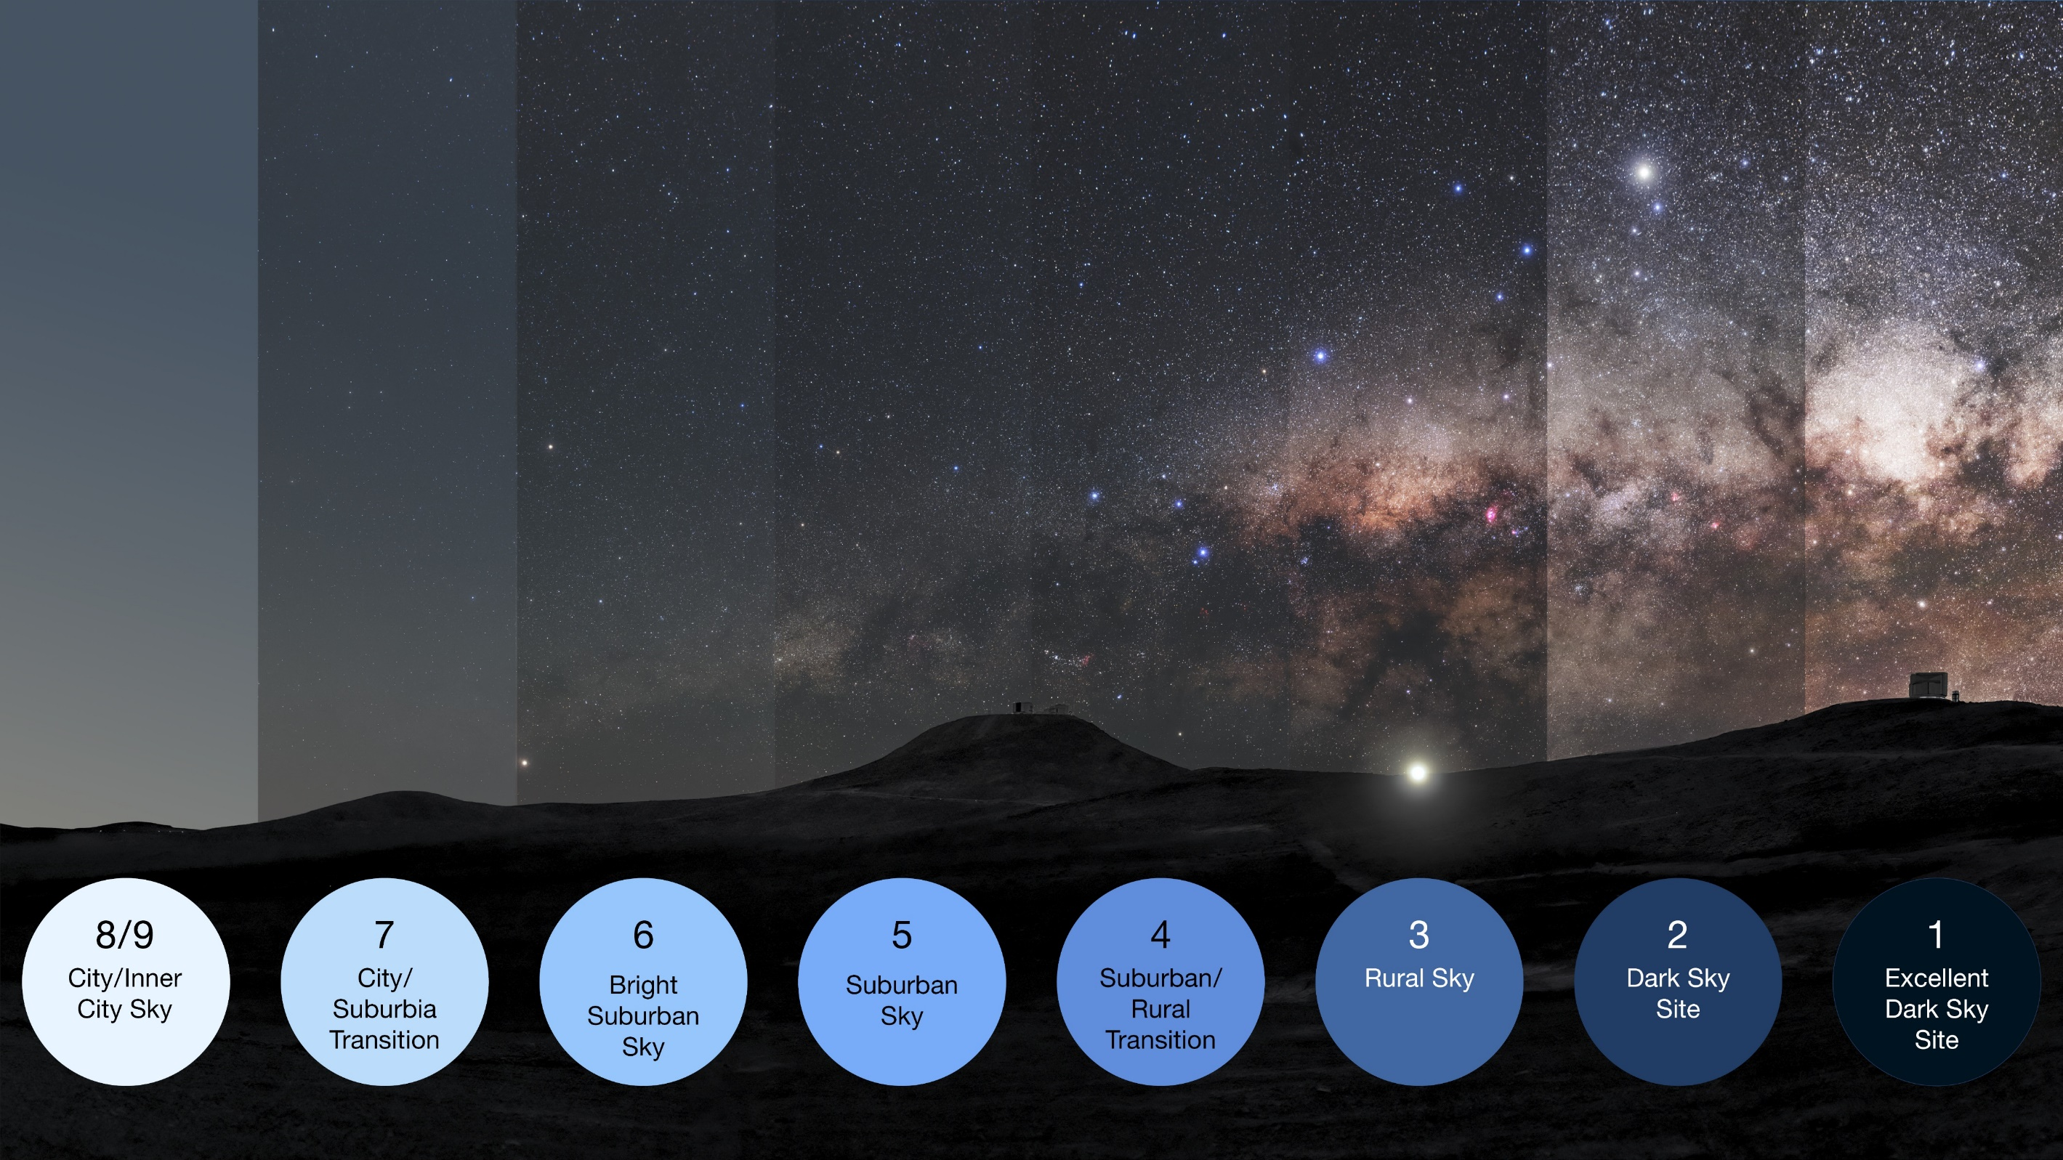
Dark Sky Lighting Principles
Minimize the amount of illumination
Minimize the area of illumination
Minimize the duration of illumination
Use long-wavelength lights
https://www.eso.org/public/images/dark-skies/
Notes:
https://www.voltlighting.com/learn/using-dark-sky-approved-lighting-to-reduce-light-pollution

Slide 22
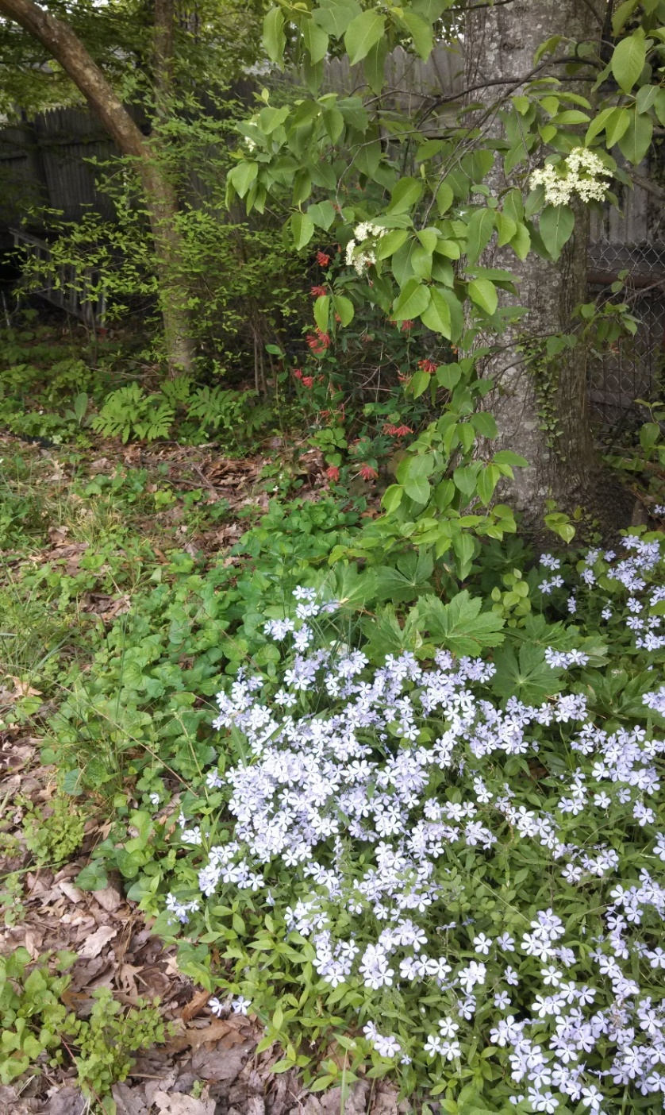
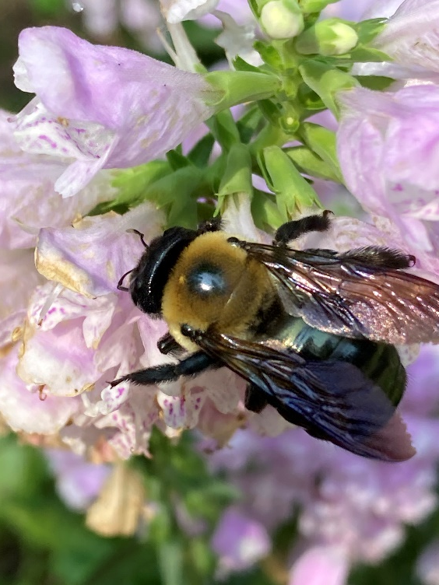
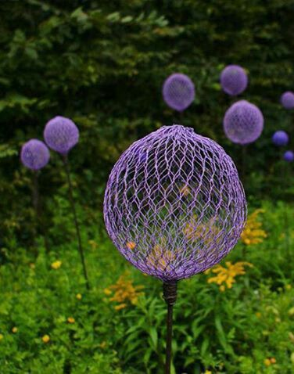
Plant Choice Matters
https://www.grandinroad.com/swarm-of-critters-garden-statues/1448678
http://www.mydiyplace.com/lawn--garden.html
Notes:
Nonnative Plants function more like statues than ecological features.
https://www.grandinroad.com/swarm-of-critters-garden-statues/1448678
http://www.mydiyplace.com/lawn--garden.html

Slide 23
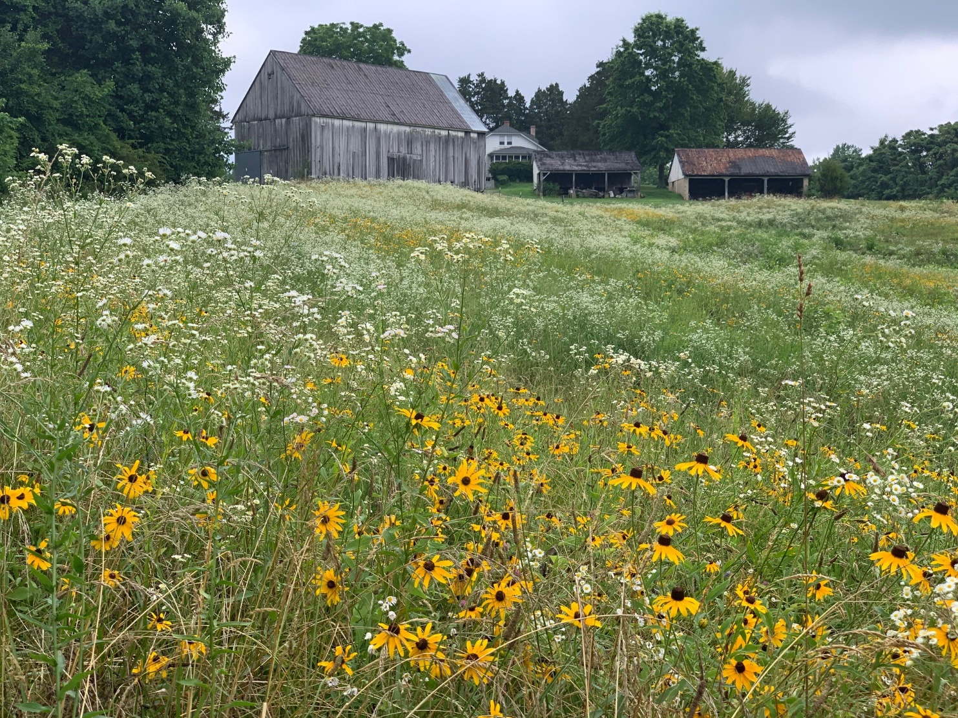
Parks are Important for Pollinators
Foraging
Nesting
Host Plants
Notes:
Foraging
Nesting
Host Plants
Maintenance and Management

Slide 24
A Sense of Place
Calvert County GIS
Notes:
Calvert County GIS

Slide 25
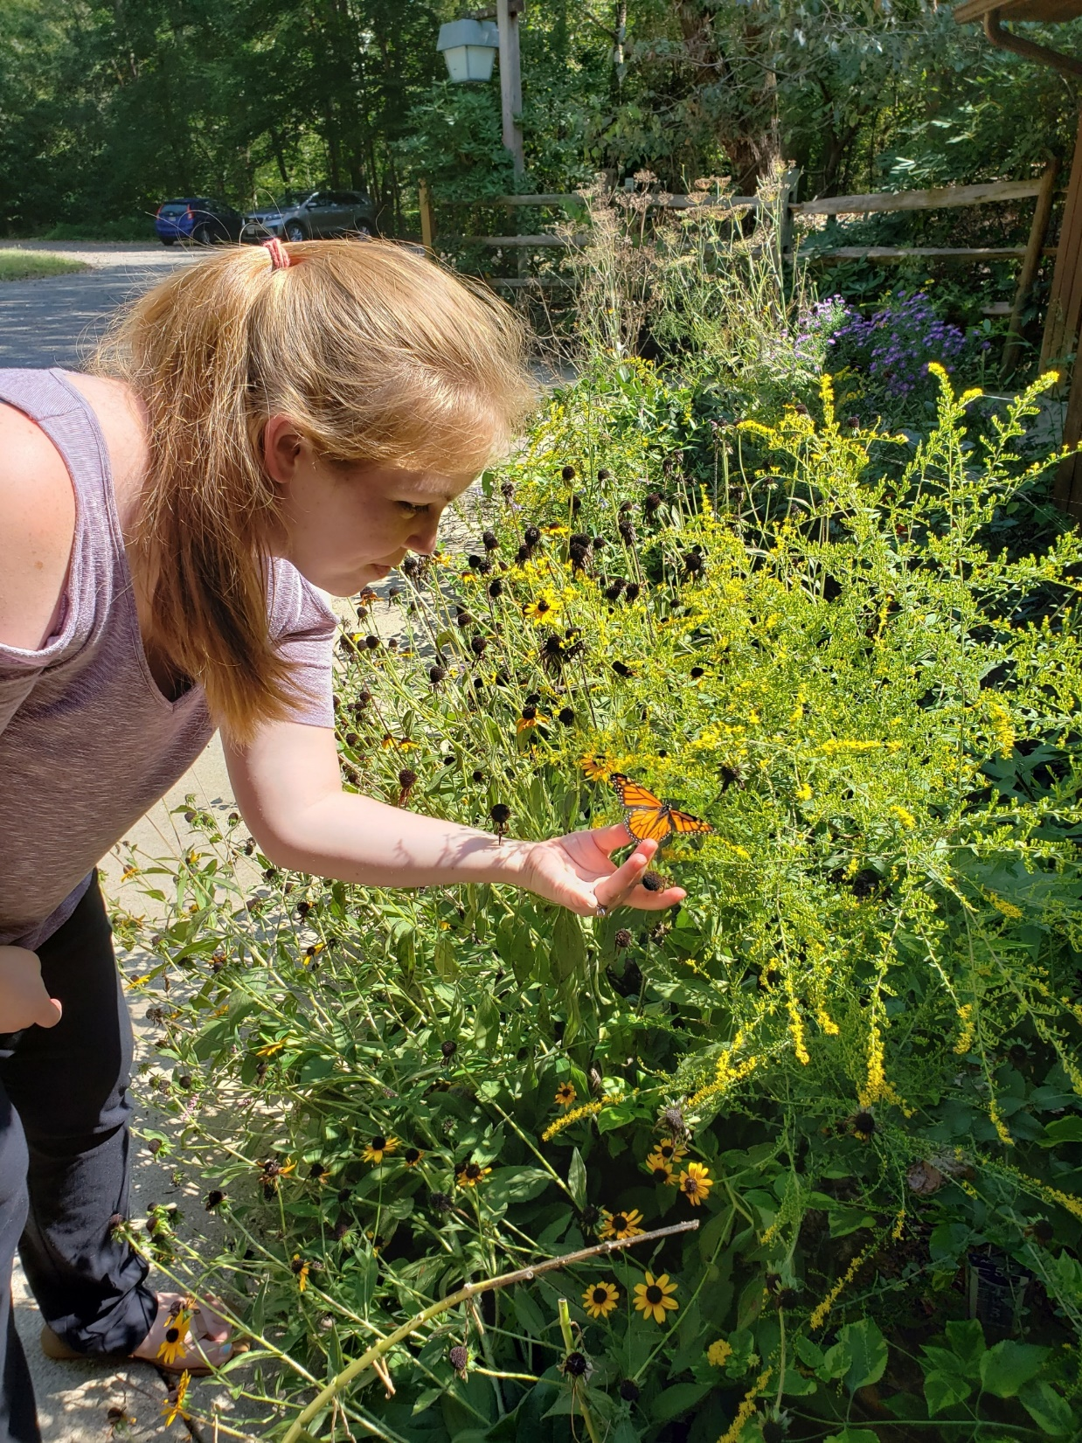
Notes:
Park and recreation agencies have a unique opportunity to help protect pollinators while advancing key sustainability plans and practices that strengthen the resiliency of their communities. Many agencies, municipalities and communities already are doing this work in some capacity. Success can be amplified by examining current efforts, identifying opportunities, and creating a team that can help build momentum and push goals forward.
Parks and Pollinators: Taking Action and Advancing Sustainability can help park and recreation professionals develop a process to assess, identify and develop the teams, practices and efforts needed to advance your pollinator and sustainability efforts. This resource also provides a self-assessment worksheet to examine work being done and a chart to inventory potential partners that can be found here: Self-Assessment for Pollinator Friendly and Sustainable Parks
“Self-Assessment for Pollinator Friendly and Sustainable Parks”
“Identify Collaborators and Opportunities”

Slide 26
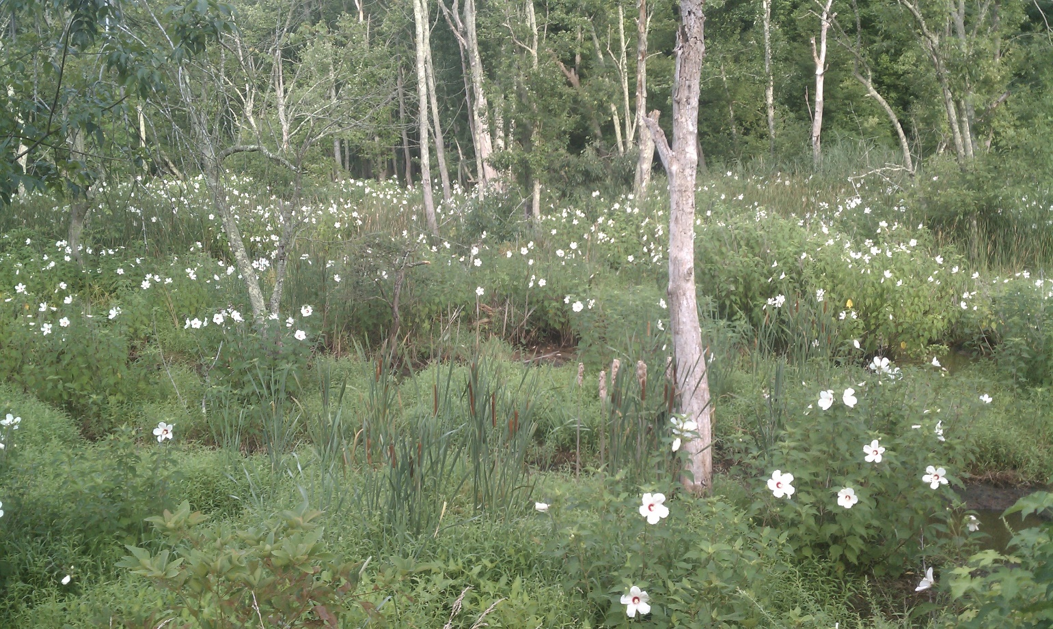
Notes:
Park and recreation agencies have a unique opportunity to help protect pollinators while advancing key sustainability plans and practices that strengthen the resiliency of their communities. Many agencies, municipalities and communities already are doing this work in some capacity. Success can be amplified by examining current efforts, identifying opportunities, and creating a team that can help build momentum and push goals forward.
Parks and Pollinators: Taking Action and Advancing Sustainability can help park and recreation professionals develop a process to assess, identify and develop the teams, practices and efforts needed to advance your pollinator and sustainability efforts. This resource also provides a self-assessment worksheet to examine work being done and a chart to inventory potential partners that can be found here: Self-Assessment for Pollinator Friendly and Sustainable Parks
“Self-Assessment for Pollinator Friendly and Sustainable Parks”
“Identify Collaborators and Opportunities”

Slide 27
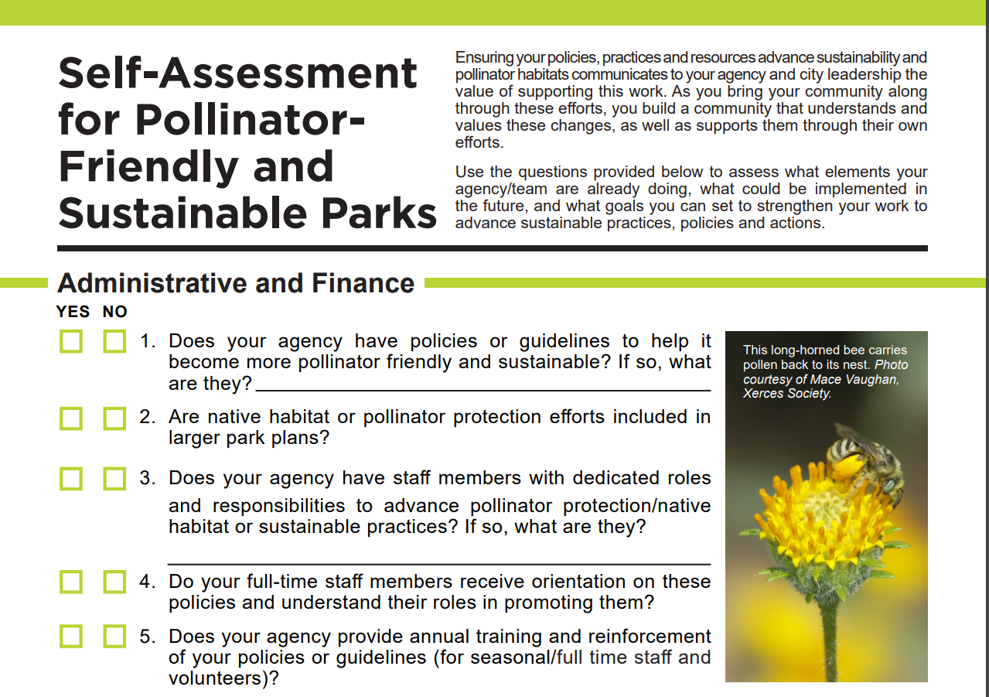
Strategies for Success
Assessment Tool
Small Group Break Outs
15 minutes
https://www.nrpa.org/globalassets/research/self-assessment-pollinator-checklist.pdf
Notes:
Park and recreation agencies have a unique opportunity to help protect pollinators while advancing key sustainability plans and practices that strengthen the resiliency of their communities. Many agencies, municipalities and communities already are doing this work in some capacity. Success can be amplified by examining current efforts, identifying opportunities, and creating a team that can help build momentum and push goals forward.
Parks and Pollinators: Taking Action and Advancing Sustainability can help park and recreation professionals develop a process to assess, identify and develop the teams, practices and efforts needed to advance your pollinator and sustainability efforts. This resource also provides a self-assessment worksheet to examine work being done and a chart to inventory potential partners that can be found here: Self-Assessment for Pollinator Friendly and Sustainable Parks
“Self-Assessment for Pollinator Friendly and Sustainable Parks”
“Identify Collaborators and Opportunities”

Slide 28
Parks For Pollinators
Create Foraging Habitat
Support Reproduction
Provide Shelter
Remove Invasive/Exotic Species
Reduce Chemical Use
Monitor Efforts
Spread the Word

Slide 29
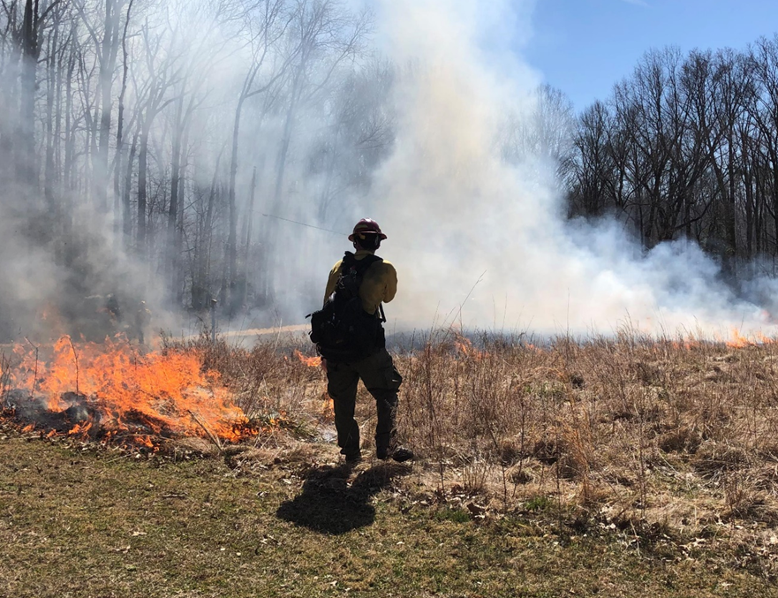
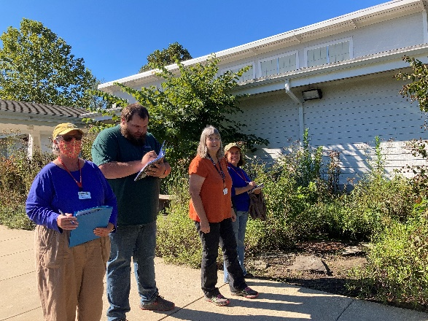
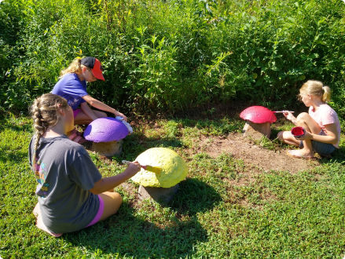
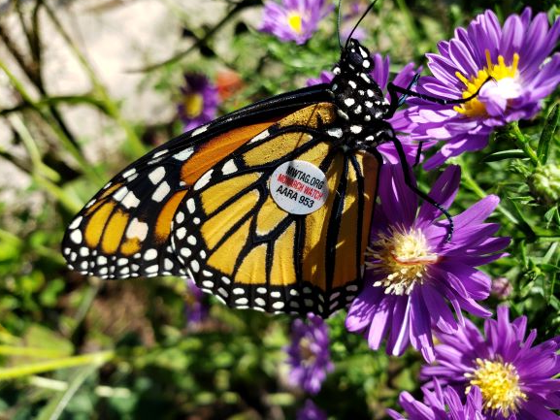
Park Projects

Slide 30
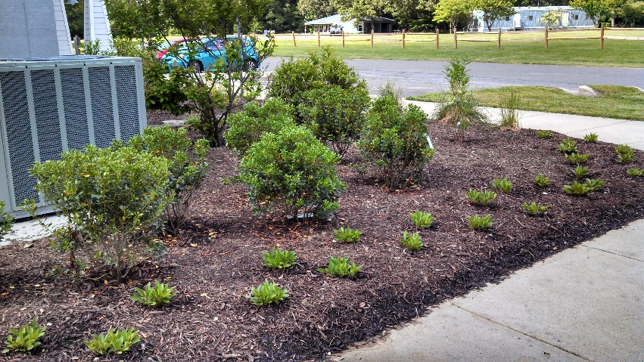
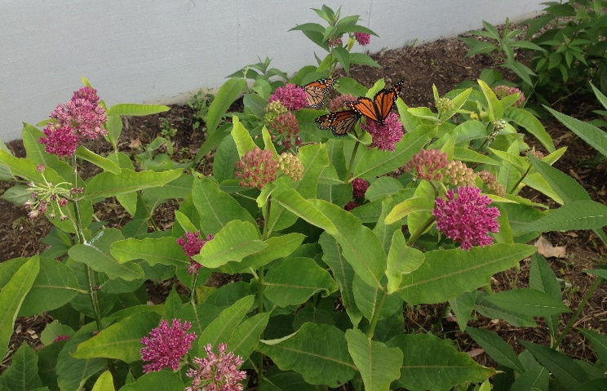
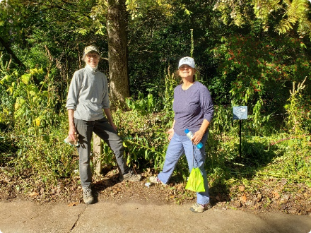
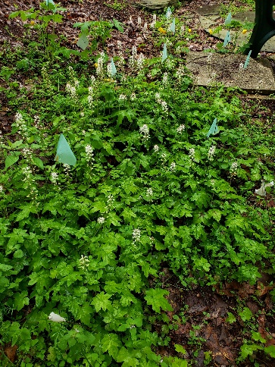
Gardens

Slide 31
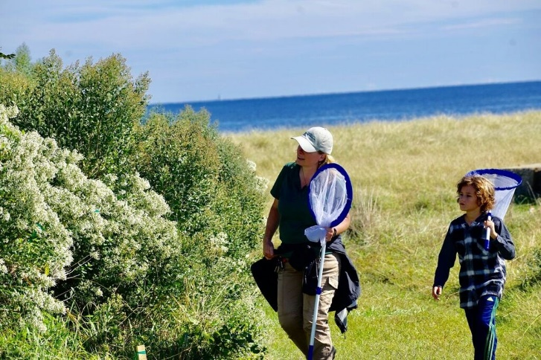
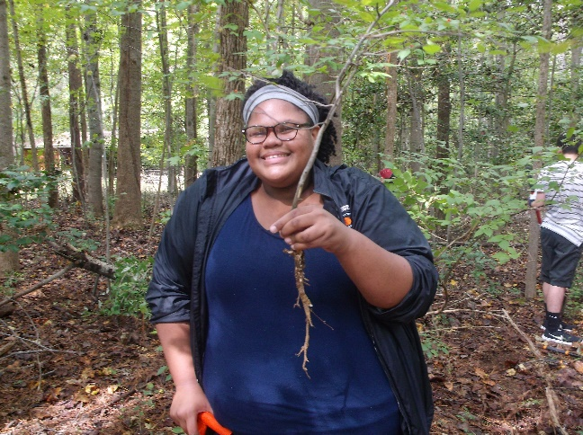
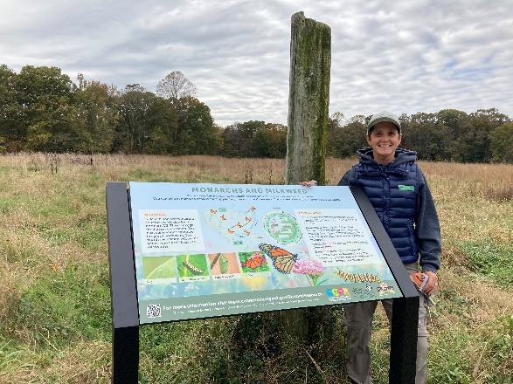
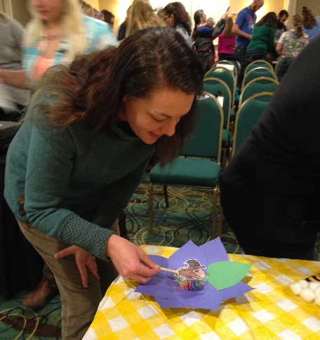
Outreach & Interpretation

Slide 32
NRPA Parks for Pollinators
Raise awareness of pollinators nationwide by hosting a Parks for Pollinator BioBlitz in your community
The entire month of September.
Sign up for the 2023 BioBlitz
https://www.nrpa.org/our-work/Three-Pillars/conservation/parks4pollinators/bioblitz/

Slide 33
Resources
Xerces Society: Pollinator Friendly Parks https://xerces.org/publications/guidelines/pollinator-friendly-parks)
Monarch Joint Venture, Advocate for Monarchs https://monarchjointventure.org/get-involved/advocacy
National Wildlife Federation https://www.nwf.org/Home/Garden-for-Wildlife
Homegrown National Park https://homegrownnationalpark.org/
Wild Ones Natural Landscapers, Native Garden (designs for residents) https://nativegardendesigns.wildones.org

Slide 34
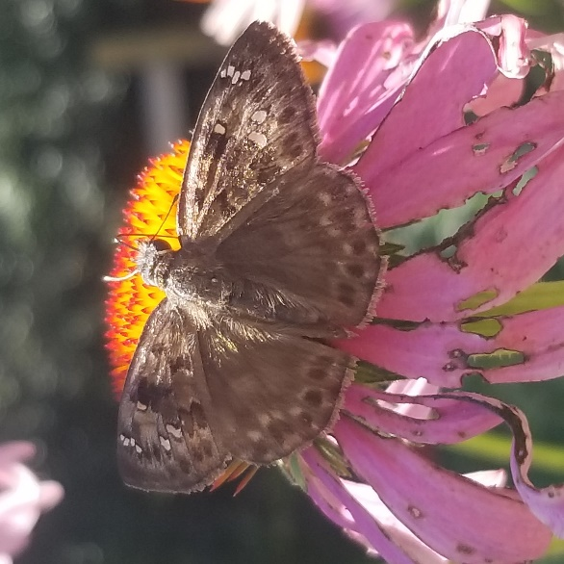
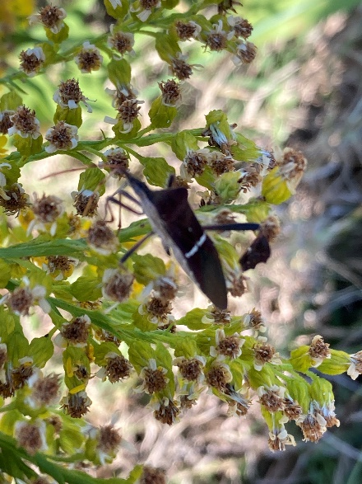
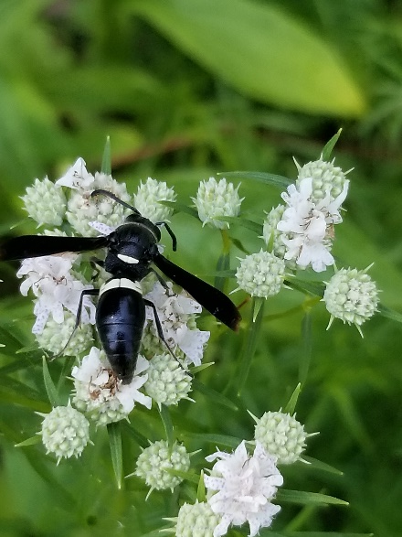
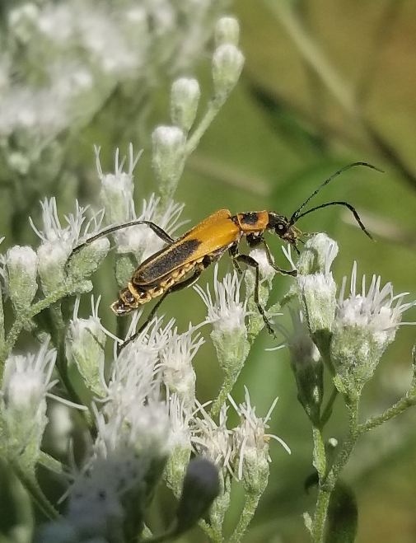
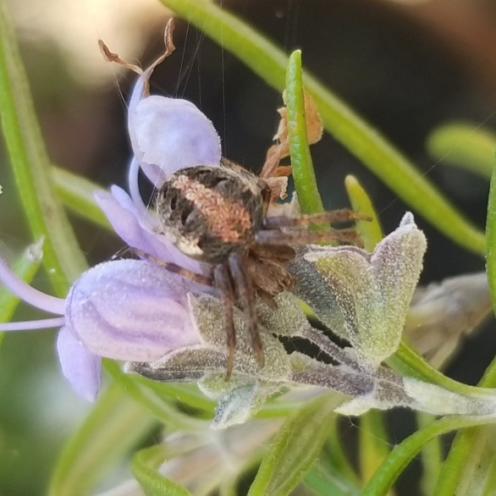
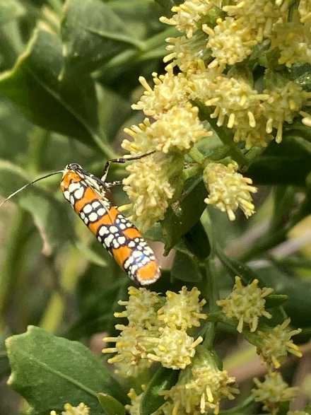
www.calvertparks.org/activities/pollinators

Slide 35
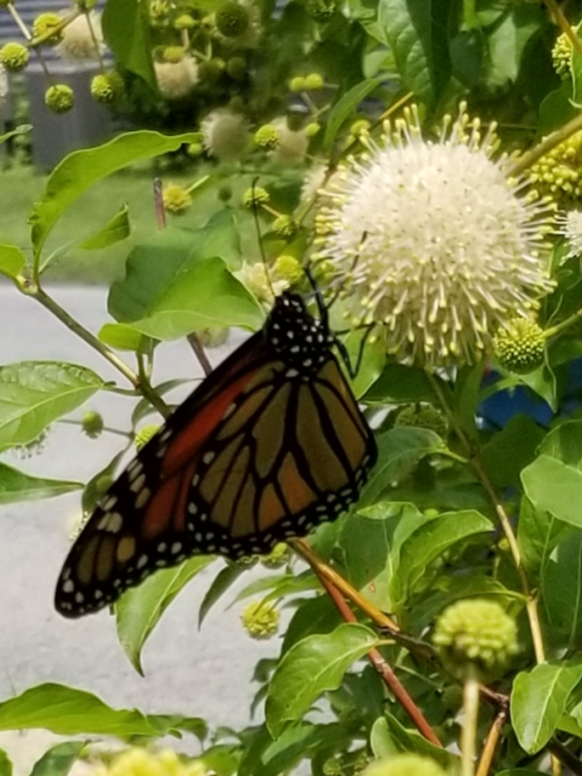
Final Thoughts
www.calvertparks.org/activities/pollinators

Slide 36
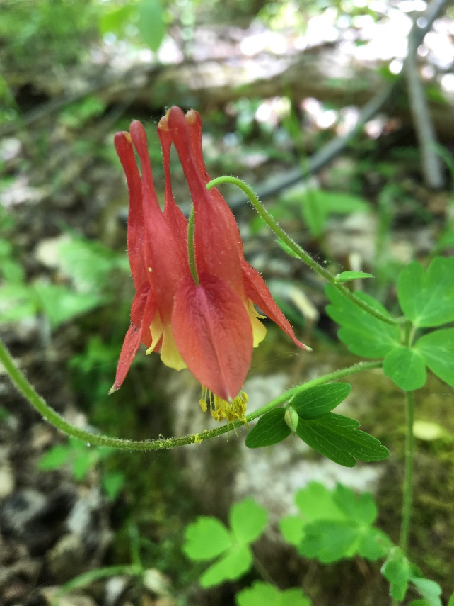
Questions?
Karyn Molines Karyn.Molines@CalvertCountyMD.gov
Victoria Hall
Riley Brown
Calvert County Parks & Recreation Natural Resources Division 410-535-5327
Unless otherwise indicated, Photos by Karyn Molines
Notes:
Thank you for giving me this opportunity to speak with you.
If at any time you have questions, please do not hesitate to reach out.

